Slide 1
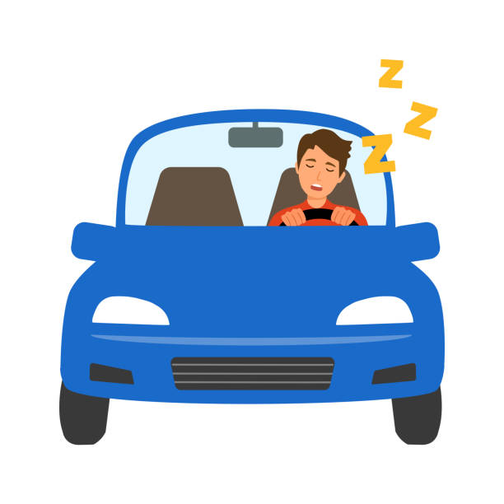
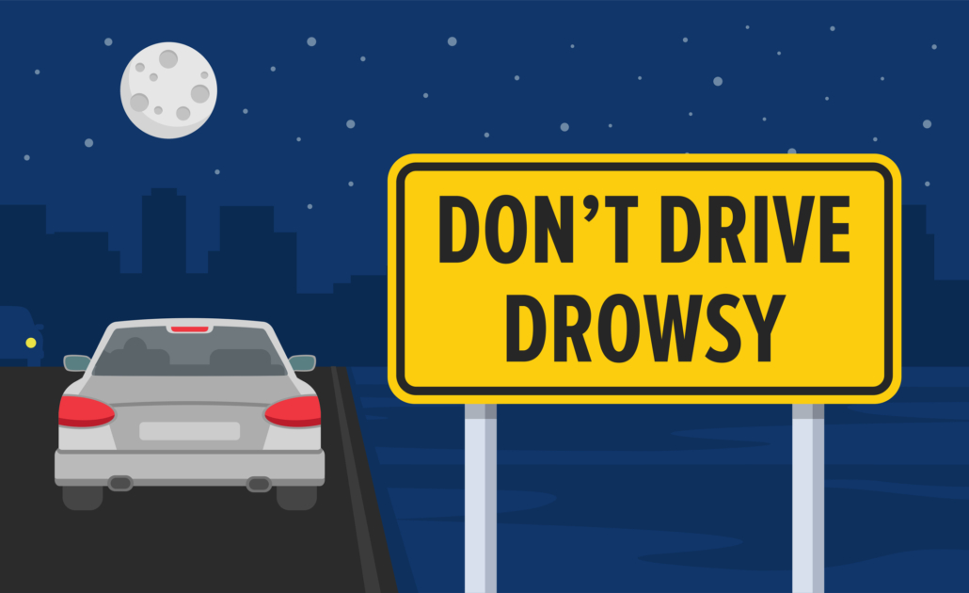
Drowsy Driver Detection System
By
Sana Bhargavi

Slide 2

Index
Description of the Problem Statement
CNN Model Architecture
Drowsiness Detection Dataset
Training the Model
Performance of the Model
Testing the Model
Building Pipeline for Predictions on Full Face Images
Conclusion.

Slide 3

Problem Statement
The project aims at detecting drowsiness while driving to alert the driver at the right time to prevent any mishappening. The project uses a CNN model to predict whether a person feels drowsy or not based on whether the eyes are closed or open. The project’s main objective was to limit the number of trainable parameters of the CNN model to under 250K so that the system can be deployed on edge or computationally less efficient devices.

Slide 4
CNN Model Architecture
The implementation uses a custom-designed Convolutional Neural Network that has the following characteristics
Three Convolution Blocks having 2, 3, and 3 convolutional layers, respectively.
A Batch Normalization Layer follows each Convolution Layer.
A Dropout Layer follows each Convolution Block for avoiding overfitting and a MaxPool Layer.
3 Fully Connected Layers follow convolution Layers for classification.

Slide 5

About Dataset
The project uses the Drowsiness_dataset present on the Kaggle platform. The original dataset contains four classes for classifying images into Open Eyes, Closed Eyes, Yawning, or No-Yawning. However, this project’s scope is to classify drowsiness based on whether the eyes are closed or open. So, I will be using only two classes of the dataset. Characteristics of the dataset are as follows
The dataset contains a total of 1452 images in two categories.
Each category has 726 images.
The dataset is already balanced, so no need to balance the dataset.
Class Labels — ‘Open Eye’ and ‘Closed Eye’.
Class Labels were encoded such that 0 represents Open Eye and 1 illustrates Closed Eye.

Slide 6
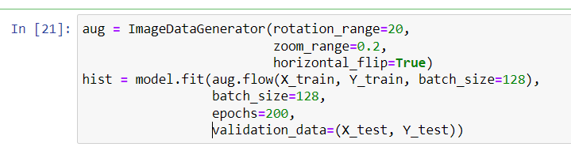

Training The Model
Model training runs for a total of 200 epochs with a batch size of 128. ImageDataGenerator is used for randomizing the training images for better performance of the model.

Slide 7

Performance of the Model
The following Performance Metrics are used
Loss vs Number of Epochs Plot
Accuracy vs Number of Epochs Plot
Classification Report
Confusion Matrix
The results of the metrics mentioned above are as follows

Slide 8
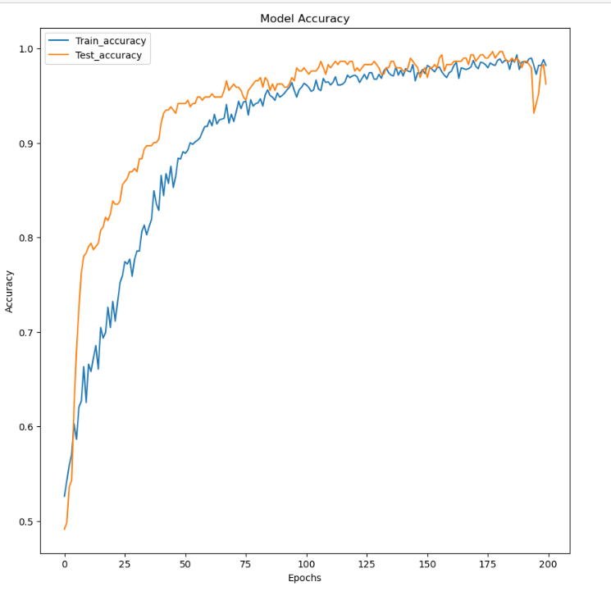

Slide 9
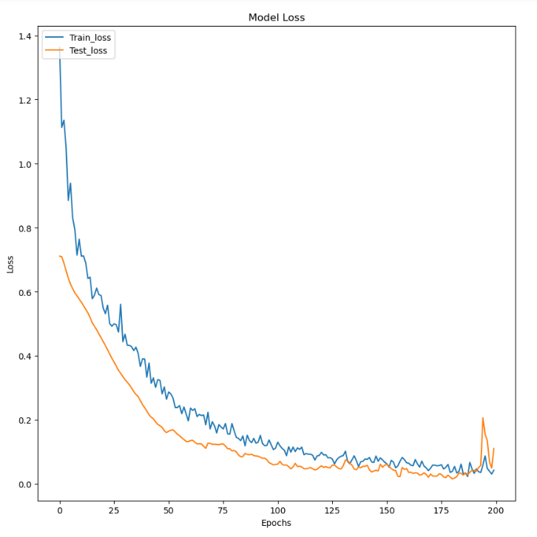

Slide 10
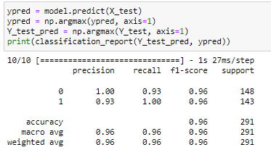
Classification Report

Slide 11
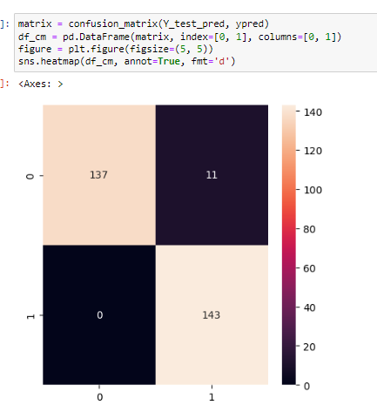
Confusion Matrix

Slide 12
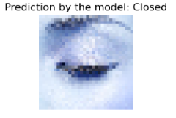
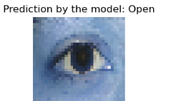
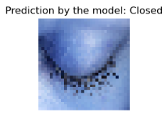
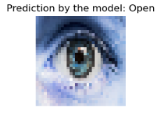
Testing the Model
The predictions of the model on images of eyes can be seen in the following pictures

Slide 13

Building Pipeline for prediction on Full Face Images
This project’s last and final step is to build a pipeline for making predictions on full-face images. The channel includes Face detection, face alignment, eyes detection, preprocessing the ROI of the image, passing to the model for prediction and displaying results on the image.

Slide 14
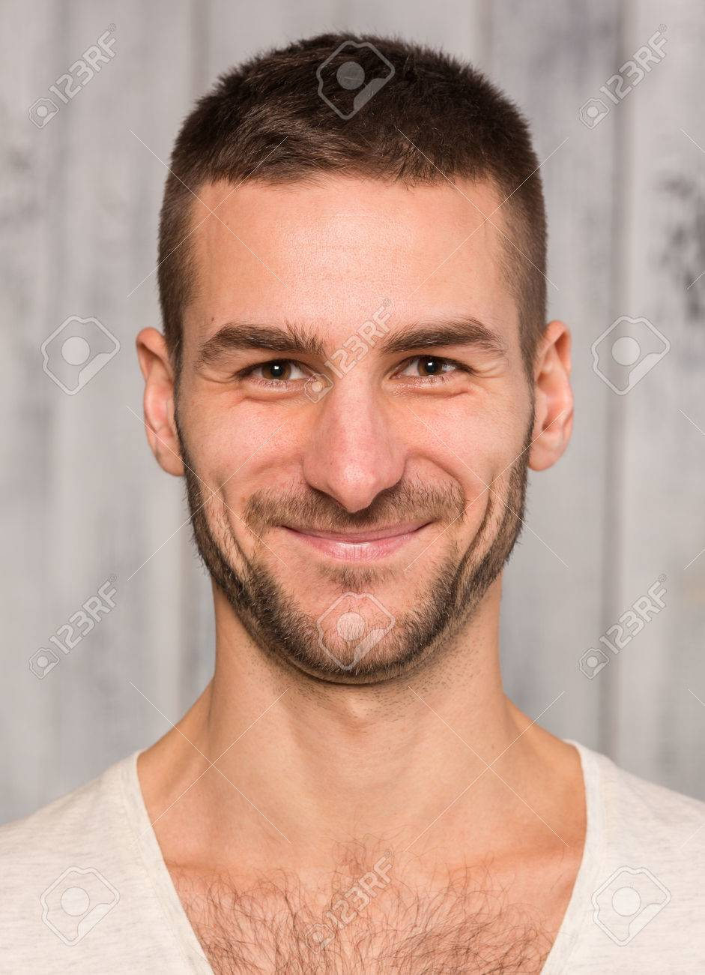
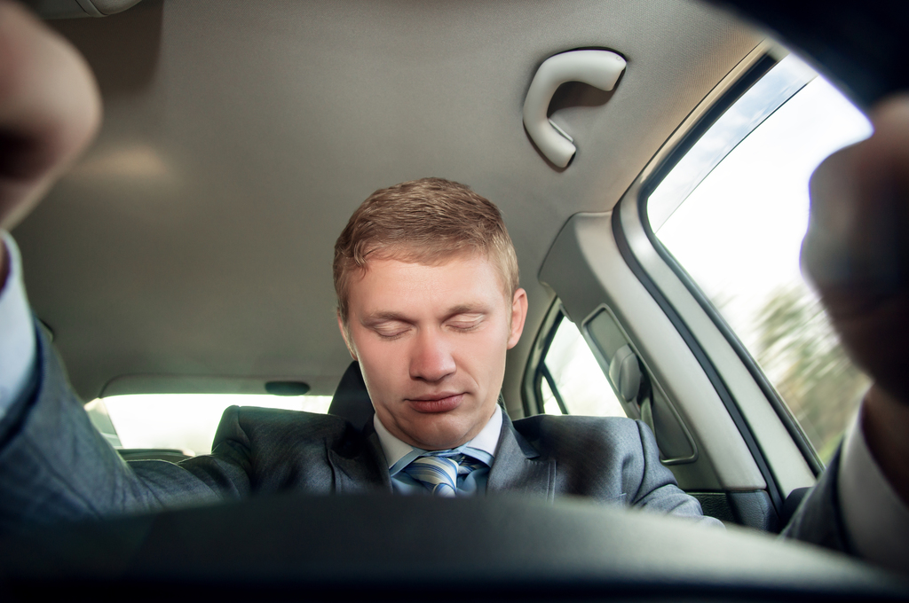

Prediction of Full Images
Active_Person
Sleepy-Driver
Drowsy_Person

Slide 15
Conclusion
Driver Drowsiness is a significant reason for thousands of road accidents all over the world. Driver drowsiness detection is a car safety technology that helps prevent accidents caused by the driver getting drowsy. The project aims at providing a solution of Driver Drowsiness Detection using CNN and image processing. The project aimed at optimizing the model to limit the number of parameters under 250k for easy deployment on edge devices. This deployment is possible through the Cainvas Platform by making use of their compiler called deepC. Thus effectively bringing AI out on edge in actual and physical real-world use cases.

Slide 16
Thank You

